Slide 1
TelarKG: a Knowledge Graph of Chile’s Constitutional Process
Renzo Angles, Vicente Calisto, Javiera Díaz, Sebastián Ferrada, Aidan Hogan, Alexander Pinto, Juan Reutter, Carlos Rojas, Henry Rosales-Méndez, Hernan Sarmiento, Etienne Toussaint, and Domagoj Vrgoč.

Slide 2
October 4, 2019

Slide 3
October 18, 2019

Slide 4
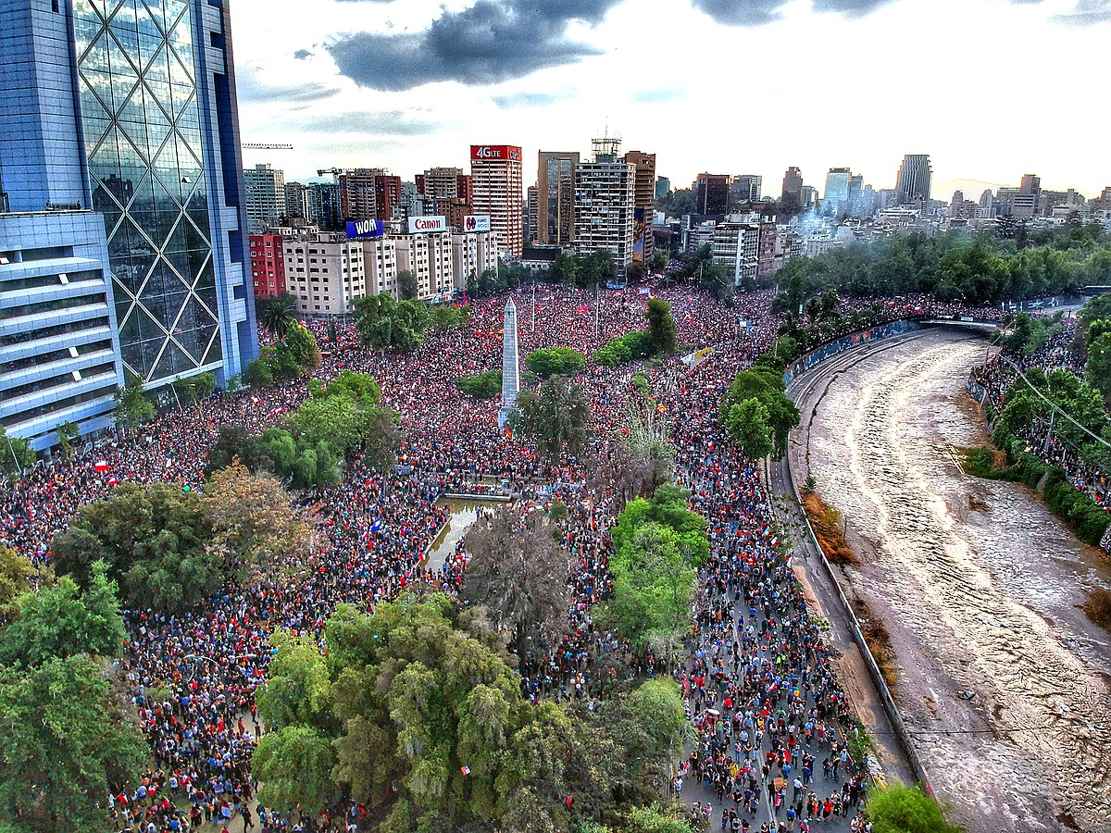
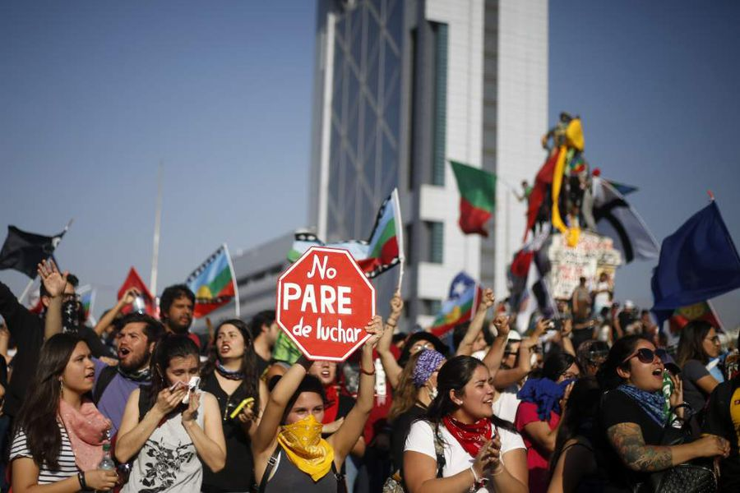
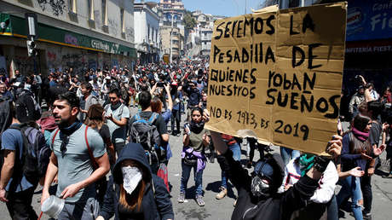
October—November, 2019

Slide 5
Pinochet’s Constitution as the Main Issue

Slide 6
November 25, 2019

Slide 7
October 25, 2020

Slide 8
May 15—16, 2021

Slide 9
July 4, 2021

Slide 10
July 4, 2022

Slide 11
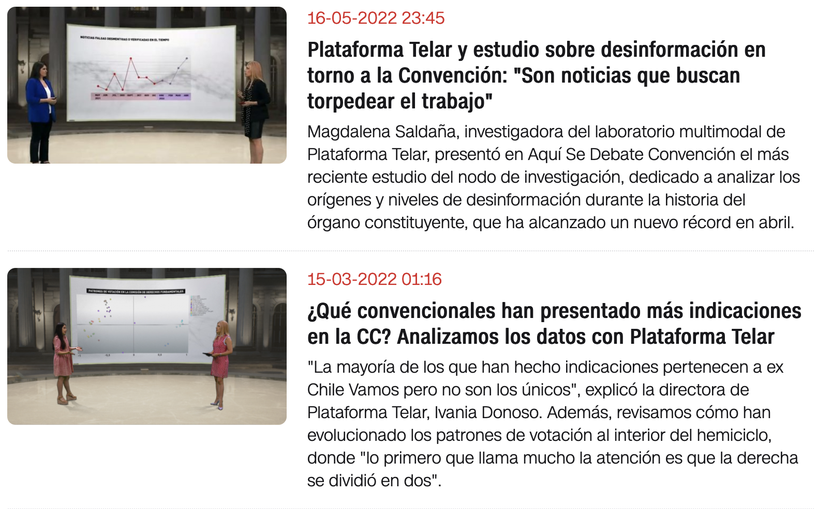
Plataforma Telar

Slide 12
TelarKG

Slide 13
TelarKG
Label | #Elements
ConventionMember | 155
CommissionMaterial | 8,715
PlenaryMatterial | 4,591
Speech | 4,099
Video | 859
Tweet (posted by a convention member) | 463,605
Tweet (containing any event-specific keyword) | 19,370,342
:vote | 874,091
:speaker | 4,085

Slide 14
TelarKG – Queries: Who leads the Discussion?
MATCH (?comm)-[?sp :speaker]->(?member),
(?member)-[?pr :party]->(?polGroup)
GROUP BY ?member, ?polGroup
ORDER BY COUNT(DISTINCT ?comm) DESC
RETURN ?member.name, ?polGroup.name, COUNT(DISTINCT ?comm)
LIMIT 7
Member.name | polGroul.name | COUNT(?comm)
Loreto Vidal | IND | 76
Constanza Hube | UDI | 71
Bastián Labbé | IND | 60
Mauricio Daza | IND | 59
Luis Jiménez | PO | 59
Marcos Barraza | PC | 53
Benito Baranda | IND | 51
Convention members who were most active in commission discussion

Slide 15
TelarKG – Queries: Intra-Party Opinion Diversity
MATCH (pers_mena_felipe)<-[?p1 :vote]-(?material :PlenaryMaterial),
(pers_mena_felipe)-[:party]->(?y),
(?x)<-[?p2 :vote]-(?material), (?x)-[:party]->(?y)
WHERE ?p1.voteWord != ?p2.voteWord
GROUP BY ?material.material
RETURN ?material.material, COUNT(?x)
Number of convention members of the same party of Felipe Mena, who voted differently than him on each material
Material | COUNT(?x)
Free trade of traditional seeds | 2
Protection of the Antarctic Territory | 6
Autonomy of Customer Protection Serv. | 7
Permanent Residence Permit after 5 years | 8

Slide 16
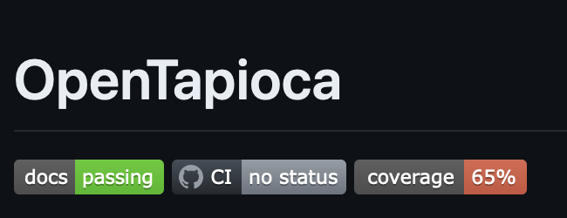
TelarKG – Entity Linking
ConventionMember
:entity
Tweet
Mention
117,680
:mention
111,840
:entity
Party
Notes:
117,680 of which are to convention members and 111,840 to partie

Slide 17
TelarKG – Entity Linking
MATCH (?twt :Tweet)-[:mention]->()->(?y1:ConventionMember),
(?twt :Tweet)-[:mention]->()->(?y2:ConventionMember)
WHERE ?y1 != ?y2
GROUP BY ?y1, ?y2
ORDER BY COUNT(?twt) DESC
RETURN ?y1, ?y2, COUNT(?twt)
LIMIT 1
The pair of conventionals most often mentioned together
?y1 | ?y2 | COUNT(?twt)
Jorge Baradit | Fernando Atria | 643

Slide 18
TelarKG – Sentence-Bert Feature Vectors

Slide 19
TelarKG – Semantic Similarity Search
Bancada | COUNT | AVG(dist)
Mov. Soc Constituyentes | 51 | 0.423795
Indep. No Neutrales | 4 | 0.475289
Frente Amplio | 95 | 0.501312
Partido_Comunista | 41 | 0.513067
Ex LDP | 31 | 0.575289
Colectivo Socialista | 25 | 0.616303
Vamos por Chile | 27 | 0.646724
Pueblo Constituyente (ex LDP) | 11 | 0.673799
UDI | 11 | 0.686078
MATCH (?tw :Tweet)->()<-(?convMemb :ConventionMember),
(twp_1494…)->(:TwitterAccount)<- (?author :ConventionMember),
(?author)-[:politicalGroupConvention]->(?authorPConv),
(?convMemb)-[:politicalGroupConvention]->(?convMembPConv)
PROJECT_SIMILARITY(?tw, ?dist, "tweets_sbert", twp_1494142390663360512, ANGULAR)
WHERE ?tw.createdAt >= date("2022-02-17") AND ?tw.createdAt <= date("2022-02-17")
GROUP BY ?convMembPConv
RETURN ?convMembPConv, COUNT(?tw), AVG(?dist)
Notes:
La combinación de la evaluación del patrón de grafo y la busqueda por similitud. Usar índices para todos los vectores, pero solo algunos son relevantes para el patrón de grafo

Slide 20
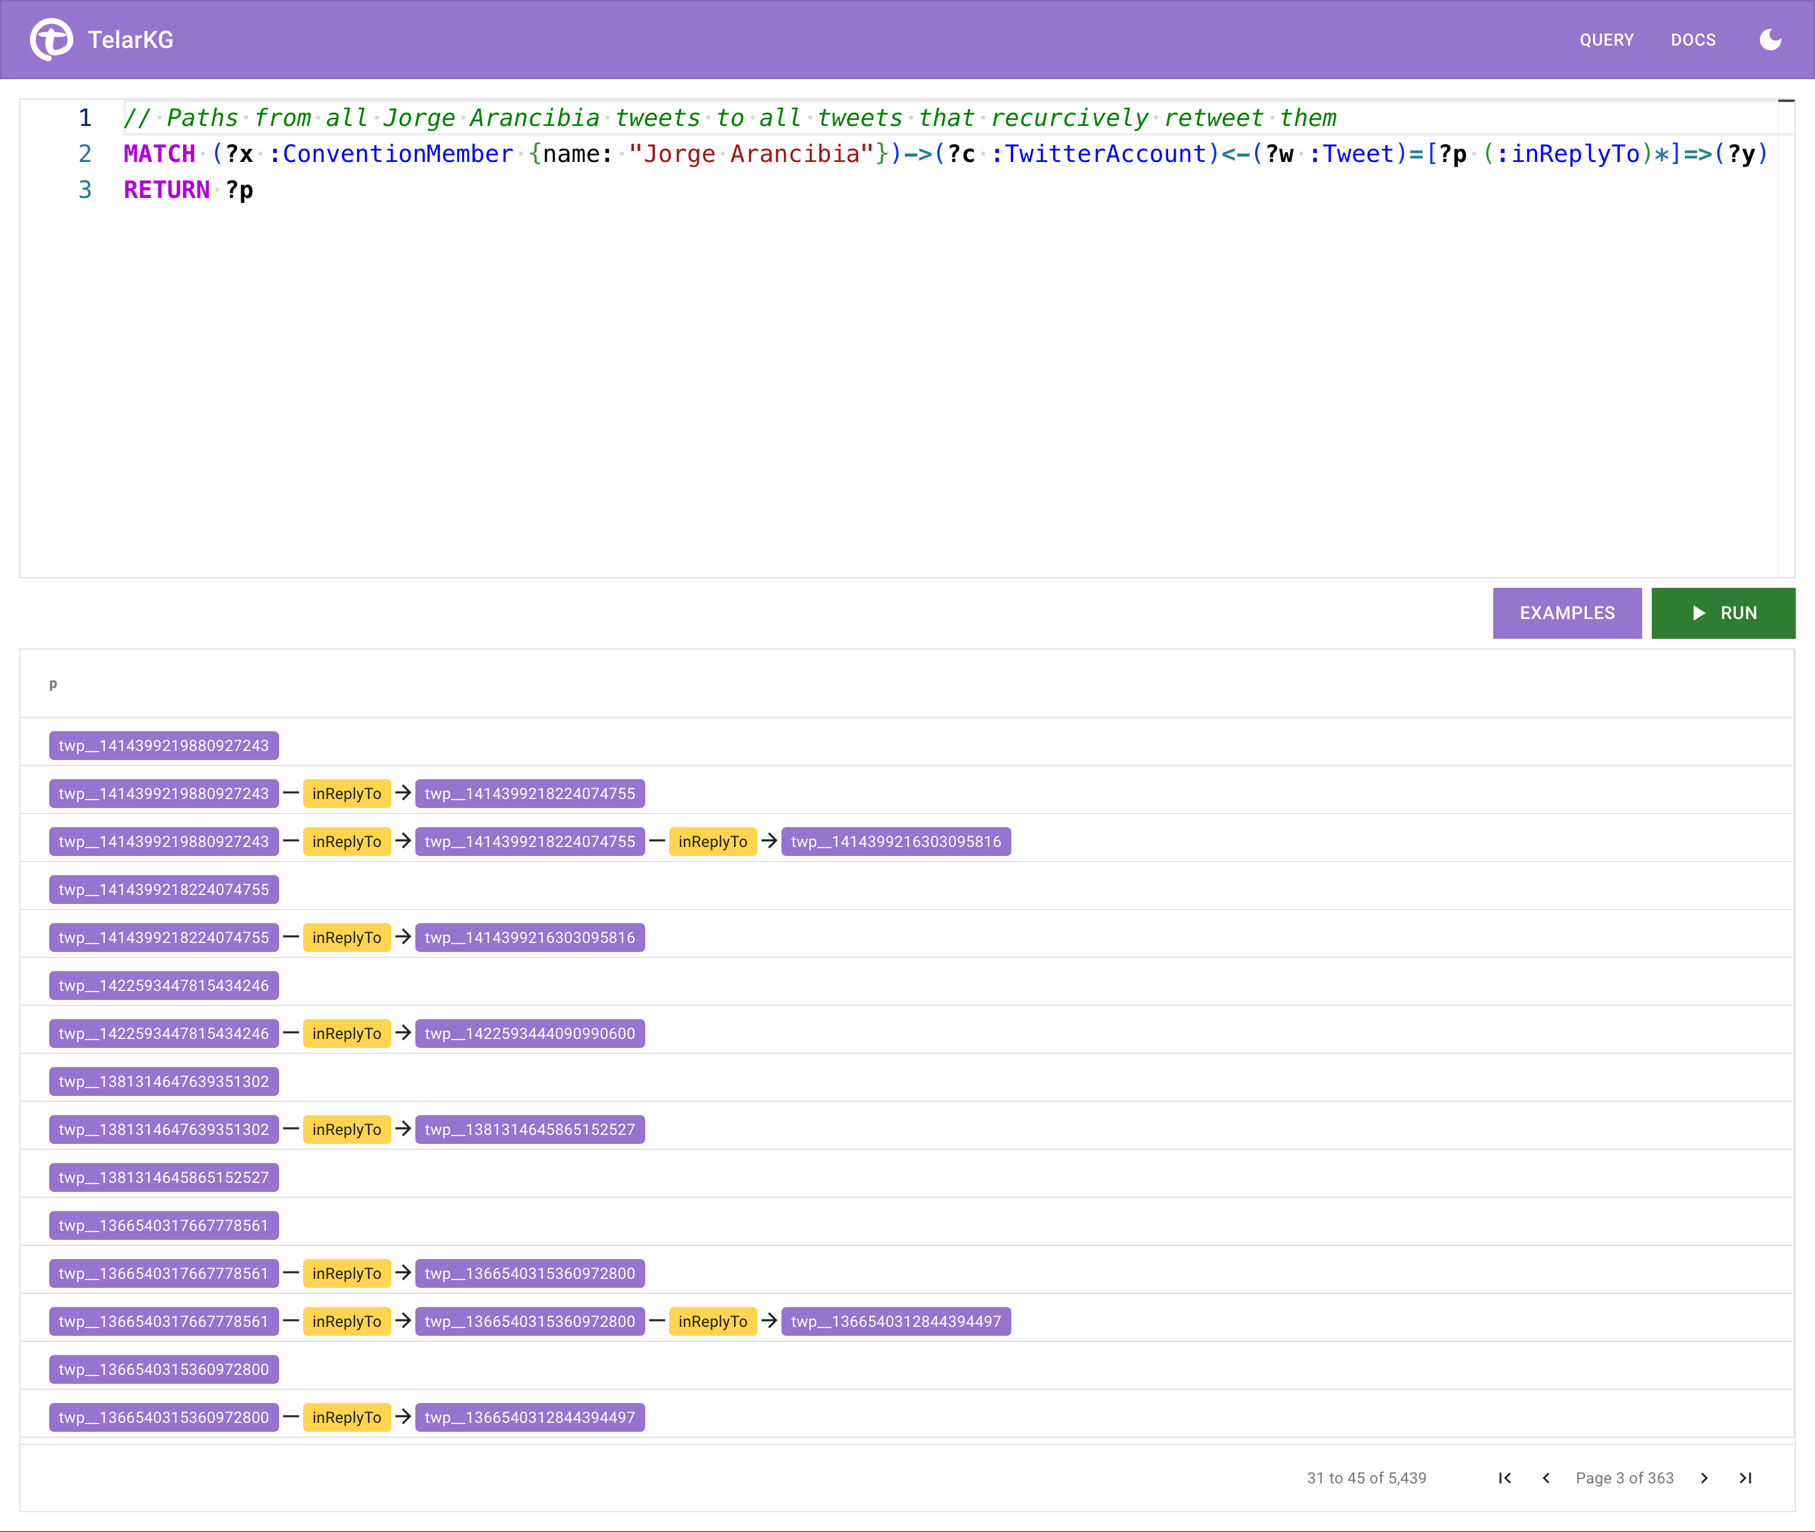
TelarKG Query Endpoint

Slide 21
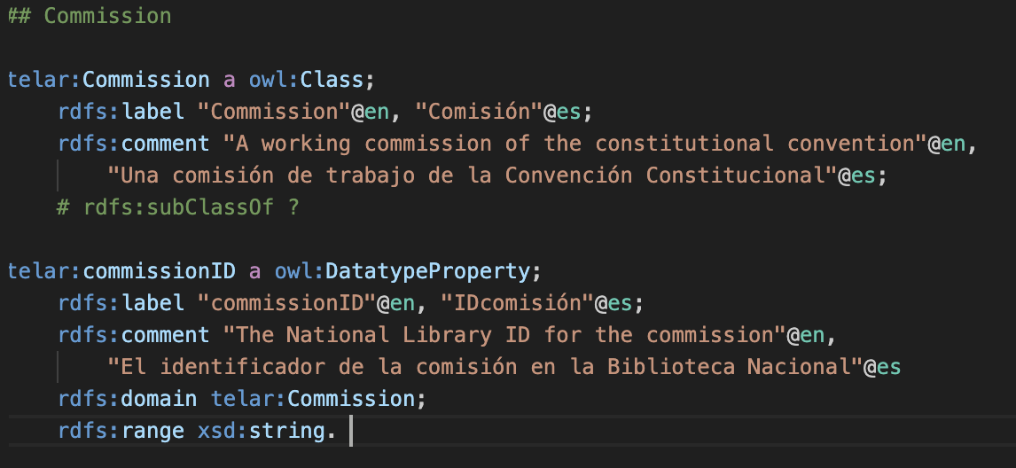
TelarKG – RDF Dump
We use a custom vocabulary that extends well-known vocabularies where relevant
All dumps: quad model, EL, and RDF

Slide 22
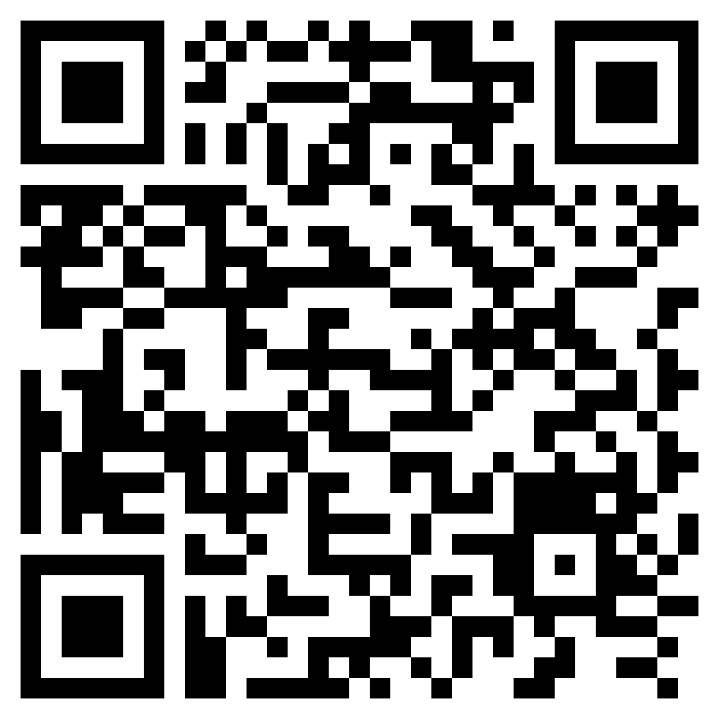
Take Aways
TelarKG is a historical and political archive that stores online and offline political discussions and voting history.
TelarKG is a pioneering effort to encode and archive political discussion that can be extended to other levels (e.g., parliament).
We leverage MillenniumDB’s vector stores and efficient similarity search capabilities to perform richer analysis.
Query Endpoint
Data Dumps
Paper

